Slide 1

WEB TECHNOLOGIES
JavaScript - Basics
Vinay Joshi
Department of
Computer Science and Engineering

Slide 2

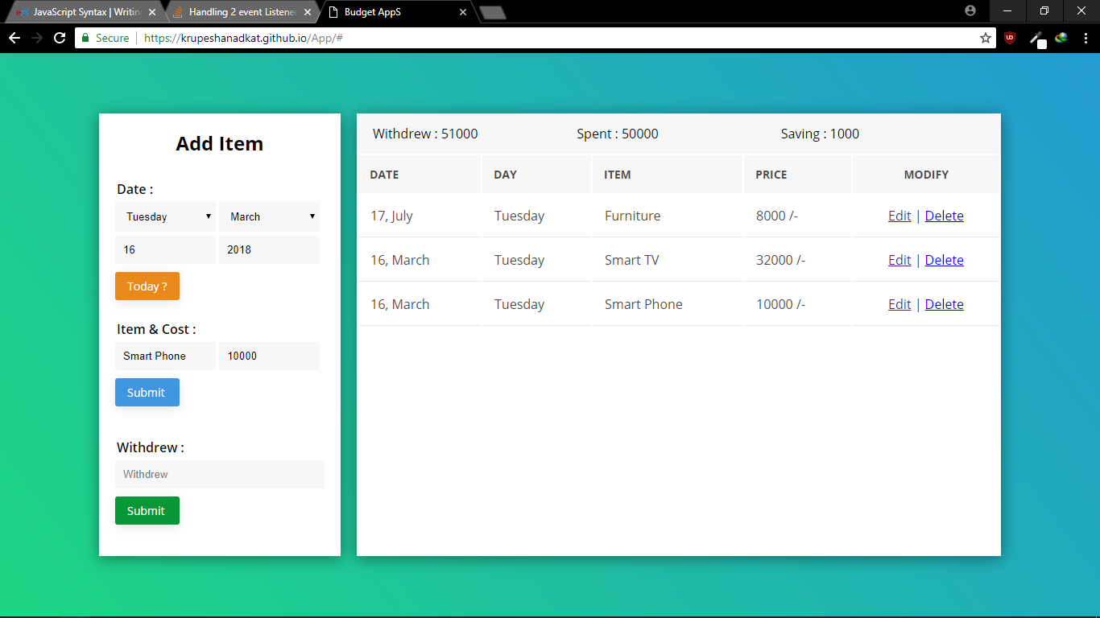
JavaScript - Basics
Introduction to JavaScript
Notes:
What you have seen so far is pages with just HTML and CSS. They are primarily static pages with contents predefined.
You have seen links been clicked and forms been submitted but loading the response in a new page.
Take an example of this page, where the contents change on the same page based on user actions and most likely without loading a new page.
This is achieved through the use of client side scripting languages like JavaScript.

Slide 3
JavaScript - Basics
Introduction to JavaScript
The web pages are of two types
Static web page
Dynamic web page

Slide 4
JavaScript - Basics
Introduction to JavaScript
JavaScript is a programming language commonly used in web development.
It was originally developed by Netscape as a means to add dynamic and interactive elements to websites.
While JavaScript is influenced by Java, the syntax is more similar to C and is based on ECMAScript, a scripting language developed by Sun Microsystems.

Slide 5
JavaScript - Basics
Introduction to JavaScript
JavaScript (js) is a light-weight object-oriented programming language which is used by several websites for scripting the webpages.
It is an interpreted, full-fledged programming language that enables dynamic interactivity on websites when applied to an HTML document.

Slide 6
JavaScript - Basics
Introduction to JavaScript
JavaScript is a client-side scripting language, which means the source code is processed by the client's web browser rather than on the web server.
This means JavaScript functions can run after a webpage has loaded without communicating with the server.
For example, a JavaScript function may check a web form before it is submitted to make sure all the required fields have been filled out. The JavaScript code can produce an error message before any information is actually transmitted to the server.

Slide 7
JavaScript - Basics
Introduction to JavaScript
Where HTML and CSS are languages that give structure and style to web pages, JavaScript gives web pages interactive elements that engage a user.
Common examples of JavaScript that you might use every day include the search box on Amazon, a news recap video embedded on The New York Times, or refreshing your Twitter feed.

Slide 8
JavaScript - Basics
Introduction to JavaScript
Client Side Scripting Language
Originally, LiveScript in NetScape Browser
JavaScript programs are run by an interpreter built into the user's web browser
Now the language has evolved with additional Server Side Scripting capabilities (like in Node.JS)

Slide 9
JavaScript - Basics
Introduction to JavaScript…(cntd.)
Pros and Cons of JavaScript
Pros
Allows more dynamic HTML pages, even complete web applications
Cons
Requires a JavaScript-enabled browser
Requires a client who trusts the server enough to run the code the server provides
JavaScript has some protection in place but can still cause security problems for clients

Slide 10
JavaScript - Basics
Introduction to JavaScript
Today, JavaScript can execute not only in the browser, but also on the server, or actually on any device that has a special program called the JavaScript engine.
The browser has an embedded engine sometimes called a “JavaScript virtual machine”.
Different engines have different “codenames”. For example:
V8 – in Chrome and Opera.
SpiderMonkey – in Firefox.
…There are other codenames like “Chakra” for IE, “JavaScriptCore”, “Nitro” and “SquirrelFish” for Safari, etc.

Slide 11
JavaScript - Basics
Introduction to JavaScript
Advantages of JavaScript
The merits of using JavaScript are −
Less server interaction − You can validate user input before sending the page off to the server. This saves server traffic, which means less load on your server.
Immediate feedback to the visitors − They don't have to wait for a page reload to see if they have forgotten to enter something.
Increased interactivity − You can create interfaces that react when the user hovers over them with a mouse or activates them via the keyboard.
Richer interfaces − You can use JavaScript to include such items as drag-and-drop components and sliders to give a Rich Interface to your site visitors.

Slide 12
JavaScript - Basics
JavaScript Code
JavaScript can be inserted into documents by using the SCRIPT tag
<html>
<head>
<title>Hello World in JavaScript</title>
</head>
<body>
<script type="text/javascript">
document.write("Hello World!");
</script>
</body>
</html>

Slide 13
JavaScript - Basics
JavaScript Code
Where to Put your Scripts
You can have any number of script tags at any position
Scripts can be placed in the HEAD or in the BODY
In the HEAD, scripts are run before the page is displayed
In the BODY, scripts are run as the page is displayed
In the HEAD is the right place to define functions and variables that are used by scripts within the BODY

Slide 14
JavaScript - Basics
JavaScript Code – External Scripts
Scripts can also be loaded from an external file
This is useful if you have a complicated script or set of subroutines that are used in several different documents
<script src="myscript.js"></script>
The myscript.js should not include the script tags

Slide 15
JavaScript - Basics
JavaScript Code - Debugging
Debugging JavaScript Errors
- When you’re learning or using JavaScript, it’s important to be able to track typing or other coding errors.
Browser | How to access JavaScript error messages
Apple Safari | Select Safari → Preferences → Advanced → “Show Developer menu in menu bar.” You may prefer to use the Firebug Lite JavaScript module, which many people find easier to use.
Google Chrome | Press Ctrl-Shift-J on a PC, or Command-Shift-J on a Mac.
Mozilla Firefox | Press Ctrl-Shift-J on a PC, or Command-Shift-J on a Mac.
Microsoft Internet Explorer & Edge | Press F12 to call up the DevTools Console.
Opera | Select Tools → Advanced → Error Console.

Slide 16
JavaScript - Basics
Introduction to JavaScript
<html>
<body>
<script type="text/javascript">
alert("Hello Javatpoint");
</script>
</body>
</html>

Slide 17
JavaScript - Basics
JavaScript Code - Comments
Comments in JavaScript
Single line comment : //
Multiline comments : /* */

Slide 18
JavaScript - Basics
JavaScript Code – Using Semicolon
JavaScript generally automatically inserts semicolons at the end of line
x += 10 => x += 10;
However, when you wish to place more than one statement on a line, you must separate them with semicolons, like this:
x += 10; y -= 5; z = 0
When a statement spans across multiple lines, JavaScript will not raise error if the next line has a valid symbol/literal/token
return a
+ b

Slide 19
JavaScript - Basics
JavaScript Code – Variable Declaration
The first character of a variable name can be only a-z, A-Z, $, or _ then followed by only the letters a-z, A-Z, 0-9, the $ symbol, and the underscore (_)
Variable names are case-sensitive. Count, count and COUNT are three different variables
Variable can be declared using
let (block scope)
var (function or global scope)
without var or let -> use without declaring (global scope)
After assigning a value to a variable, you can change it later in the code:
let myVariable = 'Bob';
myVariable = 'Steve';
Notes:
Datatypes – primitive and objects

Slide 20
JavaScript - Basics
Introduction to JavaScript
<html>
<head>
<script type = "text/javascript">
<!--
function sayHello() {
alert("Hello World")
}
//-->
</script>
</head>

Slide 21
JavaScript - Basics
Introduction to JavaScript
<body>
<script type = "text/javascript">
<!--
document.write("Hello World")
//-->
</script>
<input type = "button" onclick = "sayHello()" value = "Say Hello" />
</body>
</html>

Slide 22
JavaScript - Basics
JavaScript Code – Datatypes
JS is loosely typed or dynamic typed
Primitive Datatypes
number
string
boolean
null
undefined
Non-Primitive Datatypes (used with new keyword)
Object
Number
String
Date
Array
Notes:
Datatypes – primitive and objects
Objects discussed in detail in L9 and L10
Mention that objects are collection of properties (key:value) accessed as object.key or object[“key”]
Number and String objects are wrapper around number and string primitive types

Slide 23
JavaScript - Basics
Introduction to JavaScript
Array:
This is a structure that allows you to store multiple values in a single reference.
let myVariable = [1,'Bob','Steve',10];
Refer to each member of the array like this:
myVariable[0], myVariable[1], etc

Slide 24
JavaScript - Basics
Introduction to JavaScript
Variables
Local Variable
Global variable
Window object
-A JavaScript global variable is declared outside the function or declared with window object. It can be accessed from any function.

Slide 25
JavaScript - Basics
Introduction to JavaScript
The window object represents a window in browser. An object of window is created automatically by the browser.
Window is the object of browser, it is not the object of javascript. The javascript objects are string, array, date etc.
alert() | displays the alert box containing message with ok button.
confirm() | displays the confirm dialog box containing message with ok and cancel button.
prompt() | displays a dialog box to get input from the user.
open() | opens the new window.
close() | closes the current window.

Slide 26
JavaScript - Basics
JavaScript Code – Operators and Constructs
JavaScript has most of the operators we're used to from C/Java
Arithmetic (+, - , *, /, %)
Assignment (=, +=, -=, *=/=, %=, ++, --)
Logical (&&, ||, !)
Comparison (<, >, <=, >=, ==, ===,!=,!==)
Note: + also does concatenation if one of the operands is string
Constructs: if, else, while, for, switch, case

Slide 27
JavaScript - Basics
Introduction to JavaScript
The JavaScript if-else statement is used to execute the code whether condition is true or false. There are three forms of if statement in JavaScript.
If Statement
If else statement
if else if statement
<html>
<body>
<script>
var a=20;
if(a%2==0){
document.write("a is even number");
}
else{
document.write("a is odd number");
}
</script>
</body>
</html>

Slide 28
JavaScript - Basics
Introduction to JavaScript
<html>
<body>
<script>
var a=20;
if(a==10){
document.write("a is equal to 10");
}
else if(a==15){
document.write("a is equal to 15");
}
else if(a==20){
document.write("a is equal to 20");
}
else{
document.write("a is not equal to 10, 15 or 20");
}
</script>
</body>
</html>

Slide 29
JavaScript - Basics
Introduction to JavaScript
<script>
var grade='B';
var result;
switch(grade){
case 'A':
result="A Grade";
break;
case 'B':
result="B Grade";
break;
case 'C':
result="C Grade";
break;
default:
result="No Grade";
}
document.write(result);
</script>

Slide 30
JavaScript - Basics
Introduction to JavaScript
Java script loops
There are four types of loops in JavaScript.
for loop
while loop
do-while loop
for-in loop

Slide 31
JavaScript - Basics
Introduction to JavaScript
For loop
<script>
for (i=1; i<=5; i++)
{
document.write(i + "<br/>")
}
</script>

Slide 32
JavaScript - Basics
Introduction to JavaScript
While loop
<script>
var i=11;
while (i<=15)
{
document.write(i + "<br/>");
i++;
}
</script>

Slide 33
JavaScript - Basics
Introduction to JavaScript
Do while loop
<script>
var i=21;
do{
document.write(i + "<br/>");
i++;
}while (i<=25);
</script>

Slide 34
THANK YOU
Vinay Joshi
Department of Computer Science and Engineering
vinayj@pes.edu
+91 80 2672 6622

